Slide 2

Unit 12: Using Themes and Theme Styles

Slide 3
Lesson Objectives
After completing this lesson, you should be able to:
Describe themes and templates
Explain the key features of Universal Theme
Create and use a new theme
Describe Universal Theme, Theme Styles, Theme Roller, and Template Options
Use Theme Styles
Use Theme Roller, and Live Template Options
Upload and use a CSS
Notes:
In this lesson, you learn how to alter your database application's user interface and page layout through themes and theme styles.

Slide 4
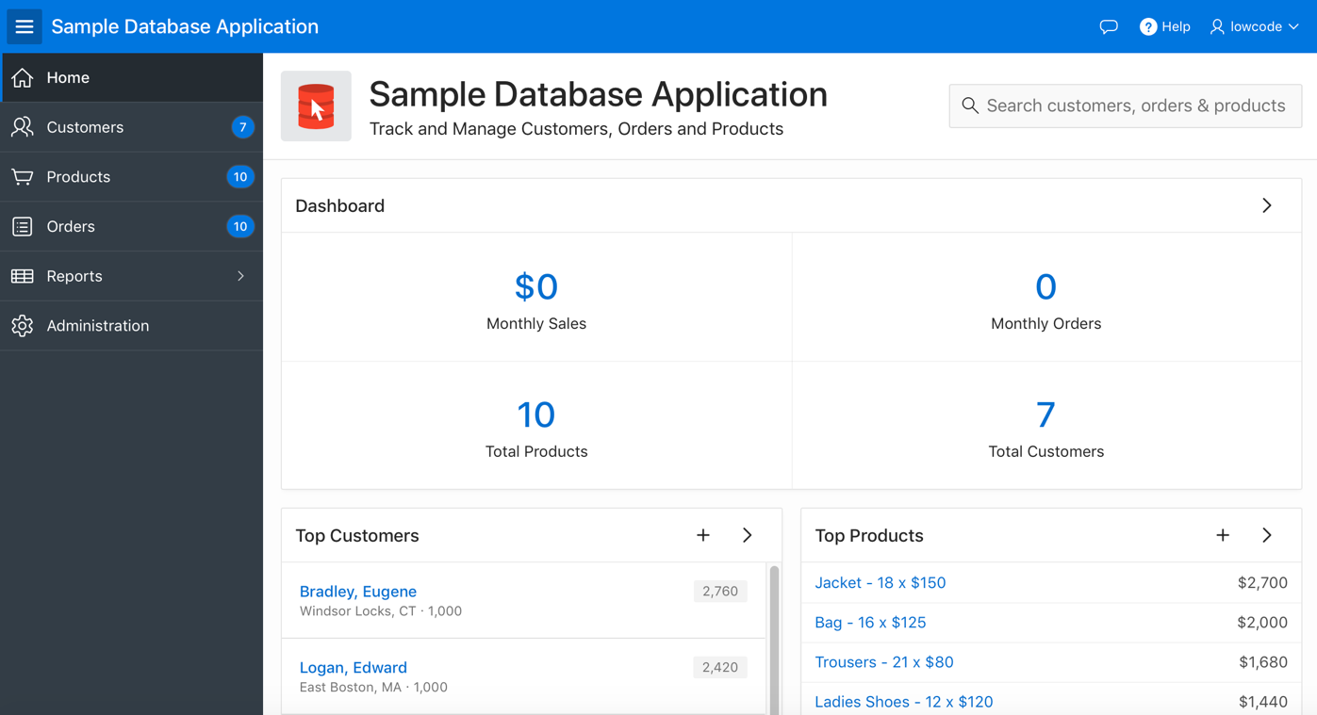
Understanding Themes
A theme identifies a collection of templates which define the look and feel of the application.
Universal Theme
Notes:
A theme is a named collection of templates that defines the application user interface. Each theme contains templates for every type of application component and page control, including individual pages, regions, reports, lists, labels, breadcrumbs, buttons, and list of values. Templates contain HTML and variables that the Application Express engine substitutes with dynamic values at runtime.
Templates are organized first by template type and then by template class. Template types include page, region, report, list, button, label, and popup list of values (LOV).
Each template type has a number of template classes. A template class defines the purpose of a template within a template type. For example, a region template can be classified as a form region template, a report region template, and so on. These classifications enable Oracle Application Express to map templates among themes, making it easy to quickly change the entire look and feel of an application.
The slide shows the Sample Database Application using Universal Theme, the user interface for Oracle Application Express applications. You learn more about the Universal Theme in the next slide.
In Oracle Application Express, administrators can add themes as follows:
Workspace Themes: Workspace administrators manage the theme repository for a workspace. Workspace administrators can add a theme to the repository, making it available to all developers within a workspace, or delete it.
Public Themes: Instance administrators can create public themes by adding them to the Oracle Application Express Administration Services. Once added, these public themes are available to all developers across all workspaces in an instance.
Note: Universal Theme - 42, uses a DIV-based grid. Pages using a DIV-based grid offer the following advantages:
Easier to maintain and update: DIV-based pages have less code and therefore less complexity.
Faster loading: Pages using a DIV-based grid generally load faster.

Slide 5

What is Universal Theme?
Default theme for Oracle APEX applications
Uses responsive HTML5 templates
Grid-layout for HTML forms
Modern flat-look
Ships with a variety of pre-built theme styles
https://apex.oracle.com/ut
Notes:
Universal Theme is a user interface for Application Express that enables developers to build modern web applications without requiring extensive knowledge of HTML, CSS, or JavaScript. With some working knowledge of Application Express, you can use Universal Theme to easily build a responsive application that is highly accessible, easily customizable, and easy to maintain.
When you create a new application, the Create Application Wizard uses the Universal Theme.
The Universal Theme is an example of a responsive user interface theme. Responsive design enables you to design web pages so that the layout fits the available space regardless of the device on which page displays (for example, a desktop computer, laptop computer, tablet, or smartphone). By implementing a responsive design, the user gets the same full experience as they would on larger screens. On smart phones and tablets, the layout can adjusts to the size of the specific device. During this resizing process, elements shift position, re-size, or become hidden. The goal of responsive design is to present all essential content in a user friendly way for all possible screen sizes. Keep in mind, that responsive design is not just a matter of picking the correct set of templates. As the application developer, you are responsible for using the templates and the available components to design a page that is truly responsive.
Note: jQuery Mobile and the jQuery Mobile User Interface used in previous releases have been de-supported. If you have an existing mobile application that uses the jQuery Mobile User Interface, you must migrate your existing application to the Universal Theme. For apps that are primarily designed for use on small screen devices, Oracle APEX includes three region types: List View, Column Toggle Report, and Reflow Report.
To learn more about Universal Theme, see https://apex.oracle.com/ut

Slide 6
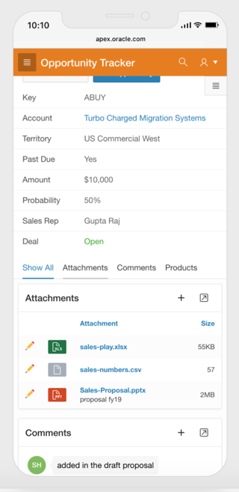
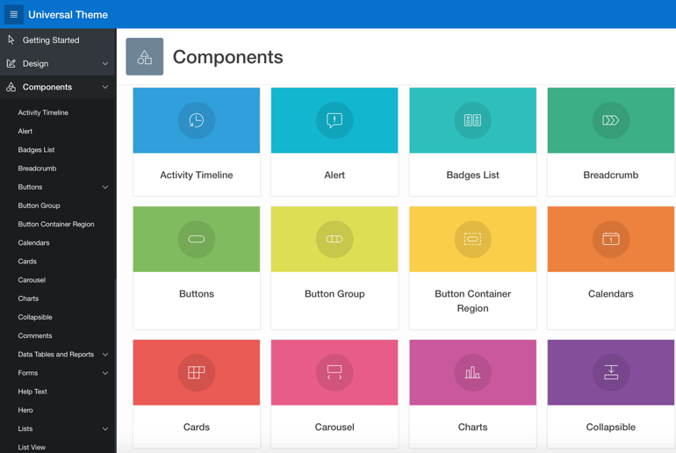
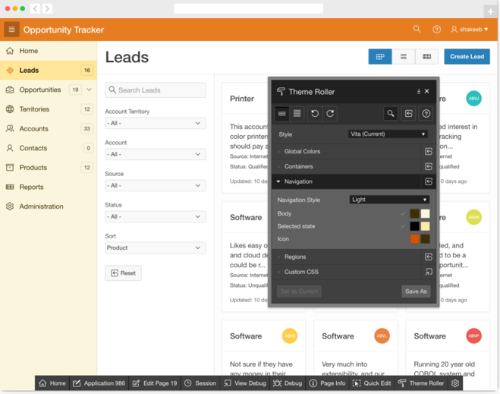
Understanding Universal Theme: Key Features
Three key aspects of Universal Theme that make it ideally suited for Oracle APEX development are:
Responsive Design
Versatile UI Components
Easy Customization
Notes:
There are three key aspects of Universal Theme that make it ideally suited for Application Express development: Responsive Design, Versatile UI Components, and Easy Customization.
Responsive Design: Universal Theme has been designed from the very beginning to work just as well on small screen devices (phones, tablet) as it does on larger screen devices (laptops, desktops). This means that the UI components such as forms, charts, reports, and more will work seamlessly across varying screen resolutions while maintaining the same or similar functionality.
Smart Layouts - Pages and screens across your application will automatically adjust to render is the most optimal way based on your viewport size. Zero effort required.
Mobile Friendly - Easily integrate touch gestures or use mobile-optimized UI patterns for navigation, page layouts, and many other components.
Grid Layout - All components on your page are placed on top of a fluid grid system that gives you total control of the layout of your page.
Versatile UI Components: Universal Theme provides the components / building blocks necessary to build practically any type of business application UI. From Cards, Forms, Menus, Tabs, Reports, and so much more, these components have been developed with the best practices following common and popular UI patterns. You can browse all of the components provided with Universal Theme by navigating to the Components section of this application: https://apex.oracle.com/ut
Common UI Patterns - There are a multitude of components based on common and well understood design patterns readily available to be used within your app.
Application Navigation - You can choose to use a tree-based navigation menu that displays to the side, a menu bar navigation near the top of the screen, or a mobile-optimized tabs display.
Live Template Options - Easily customize the appearance of any template-based component simply by making a selection or checking a box to get exactly the UI you want.
Easy Customization: Even for the most basic of requirements, theming and customization is a key and necessary ingredient to the success of your application. With Universal Theme, you can effortlessly customize and fully control the look and feel of your applications without becoming an expert in UI design, HTML, CSS, or JavaScript. Using Theme Roller and Template Options, you can easily customize your application to fit your company's brand, and customize the look and feel of various components using Template Options. All of this is possible during runtime, so what you see is what you really get.

Slide 7
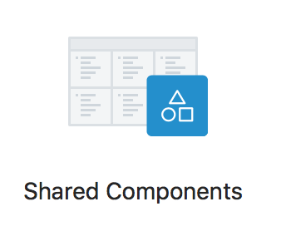
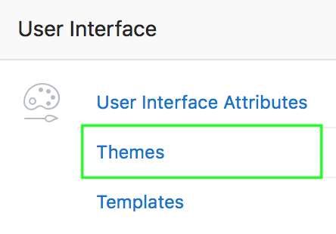
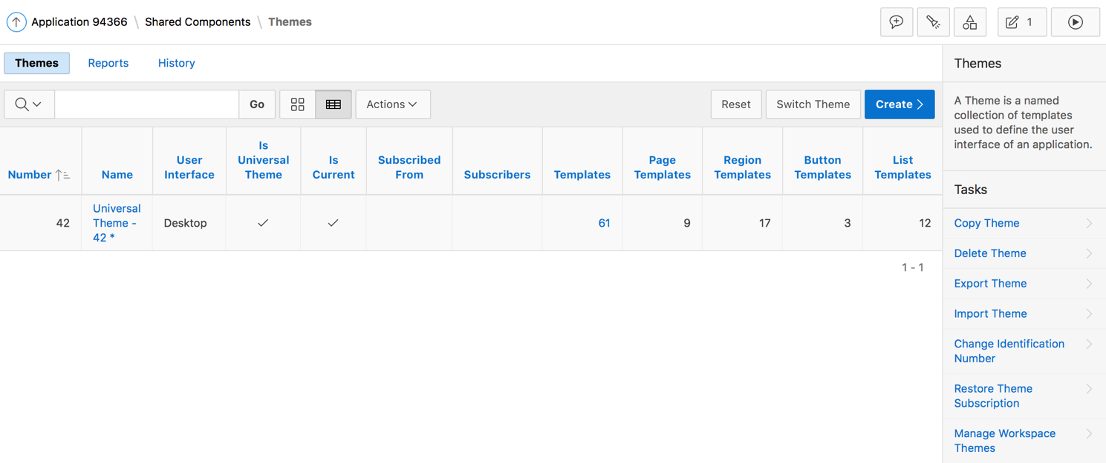
Accessing the Themes Page
1
2
3
Notes:
To access the Themes page, perform the following steps:
Navigate to your application home page and click Shared Components
Under User Interface, select Themes.
The Themes page appears as a report. The themes available for the application are displayed. A check mark in the Is Current column indicates which theme is selected. The Tasks section provides you options to copy a theme, delete a theme, export and import theme, and so on.

Slide 8
Managing Themes Using Theme Subscriptions
You can manage themes directly or through theme subscriptions
Subscribing to a master theme enables the theme to be upgraded during future Oracle APEX releases
You subscribe to a theme when:
Running the Create Application Wizard
Creating a new theme from the theme repository
Once an application subscribes to a master theme:
You can change only the default templates
All theme attributes, subscribed template options, and subscribed templates are set to read-only
Notes:
Subscribing to a master theme enables the theme to be upgraded during future Oracle Application Express releases.
Developers subscribe to a theme when:
Running the Create Application Wizard: When a developer runs the Create Application Wizard and selects a built-in theme, the theme is automatically subscribed to a master theme. When copying a theme from an existing applications, developers can choose if they wish to have this theme be subscribed to.
Creating a new theme from the Theme repository: When you create a new theme the associated application automatically subscribes to it.
Once an application subscribes to a master theme only the default templates can be changed. All theme attributes, subscribed template options, and subscribed templates are set to read-only. In other words, only the default templates can be changed. The advantage of subscribing to a master theme is that the theme can be upgraded during future Oracle Application Express releases. When a theme is subscribed to, developers cannot modify the theme or template metadata when they access it from the theme or template edit pages.
To modify a template without breaking a subscription to the master theme, you can create a local copy of the template in your workspace. Local template copies are not subscribed to and are therefore editable.

Slide 9
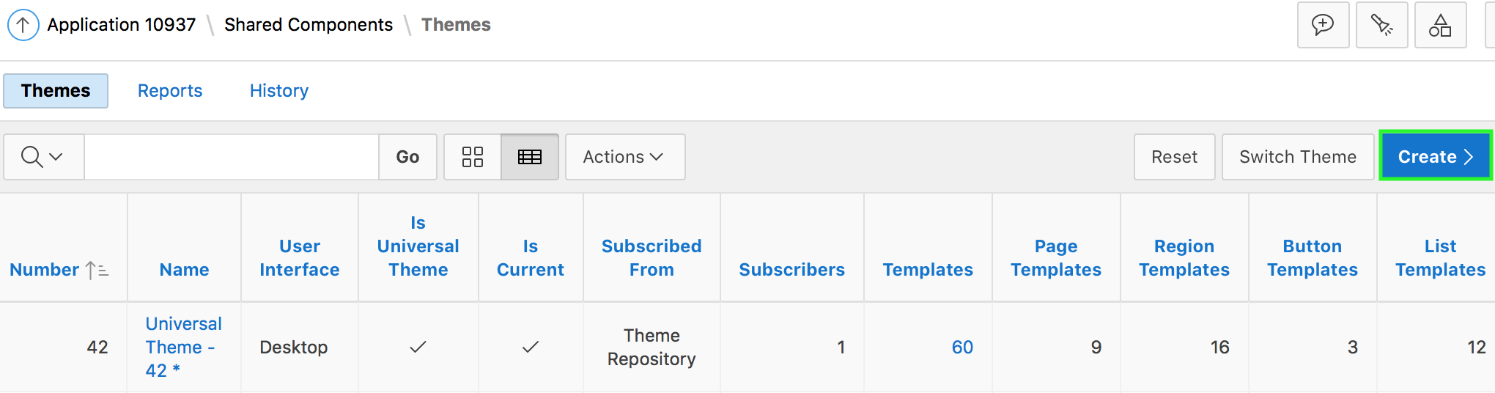
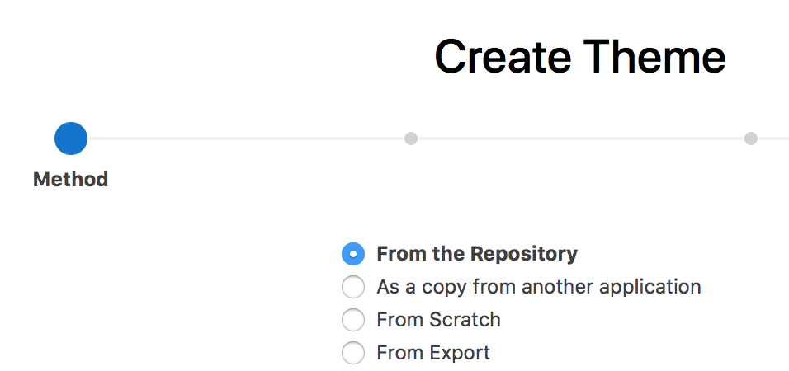
Creating a Theme
Notes:
Only themes currently associated with an application display on the Themes page. To access other themes, you must run the Create Theme Wizard. Once you create a theme, you can access it on the Themes page. You can create a theme from scratch or select an existing theme from the repository.
To create a theme, perform the following steps:
Navigate to the Themes page:
On the Workspace home page, click the App Builder icon.
Select an application.
Click Shared Components.
Under User Interface, select Themes.
The Themes page appears.
Click Create.
Select a creation method:
From the Repository - View and select a theme from the repository.
As a copy from another application - Select the application and then the theme.
From Scratch - Create a theme from scratch.
From Export - Create a theme to import from the export repository.
Follow the on-screen instructions.

Slide 10
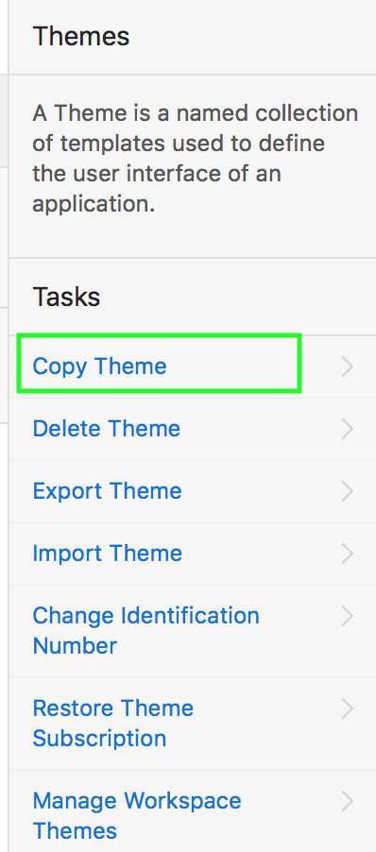
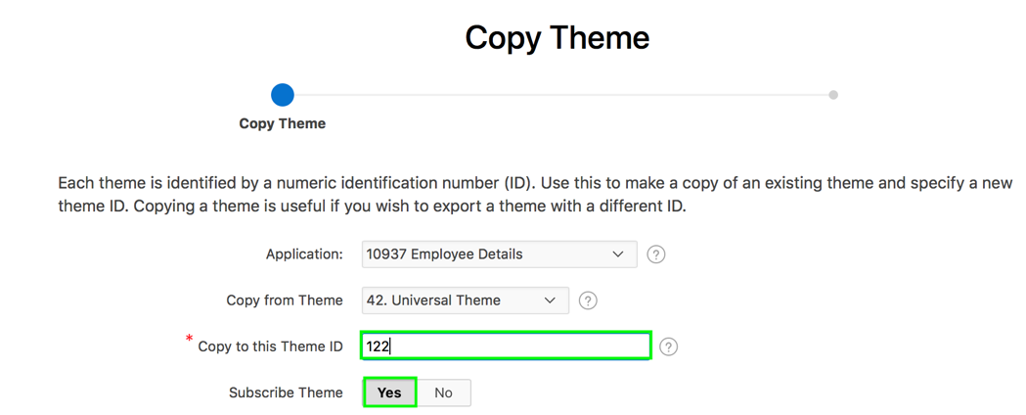
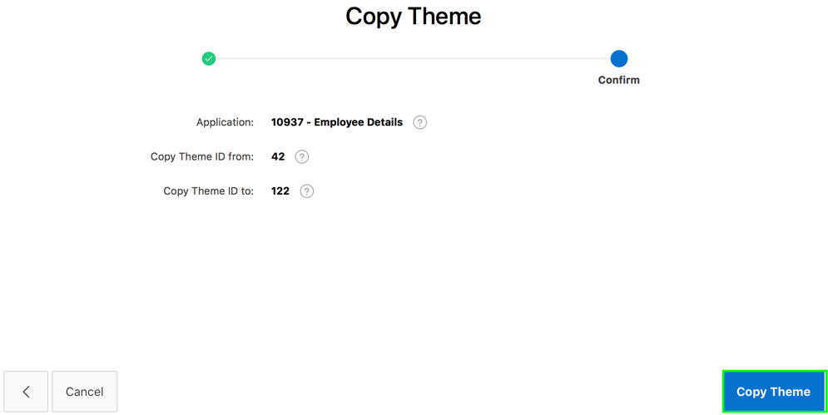
Creating a Copy of an Existing Theme
1
2
3
Notes:
The slide shows an example of creating a copy of Universal Theme. Each theme is identified by a numeric identification number (ID). When you copy a theme, you specify a theme ID. Copying a theme is useful when experimenting with editing a theme or to export a theme with a different ID.
To copy a theme, navigate to the Themes page and perform the following steps:
On the Tasks list, click Copy Theme.
On Copy Theme :
Copy From Theme: Select the theme you want to copy.
Copy to this Theme ID: Enter a new ID for the theme.
Subscribe Theme: Select Yes or No.
Then, click Next.
Click Copy Theme.
Note: Each theme has an identification number (ID). You can use the Change Theme ID utility to change a theme ID to another identification number. Changing a theme ID is useful when you want to export a theme with a different number. To use the Change Theme ID utility, on the Themes page, navigate to Tasks and click Change Identification Number.

Slide 11
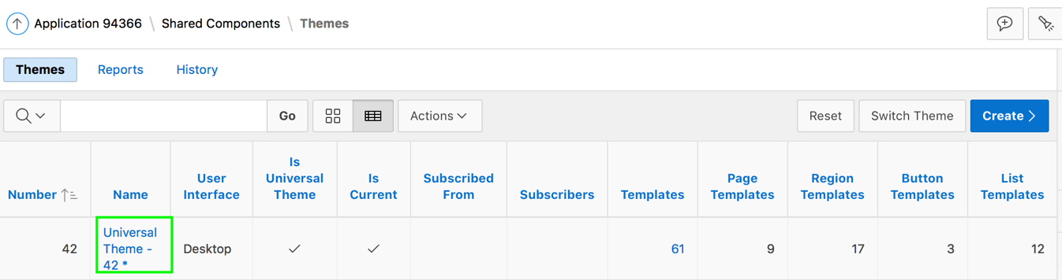
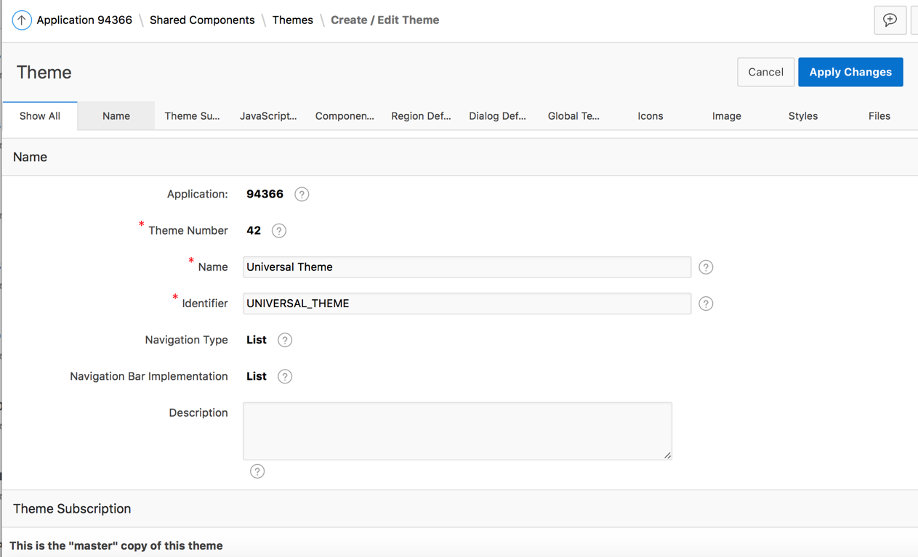
Editing a Theme
Notes:
You add additional styles to your theme by editing your theme. You learn more about theme styles later in this lesson.
To review or edit a theme, perform the following steps:
Navigate to the Themes page. Click the theme name.
The Create/Edit Theme page appears and is divided into sections. Edit the appropriate attributes.
To save any changes, click Apply Changes.
.

Slide 12
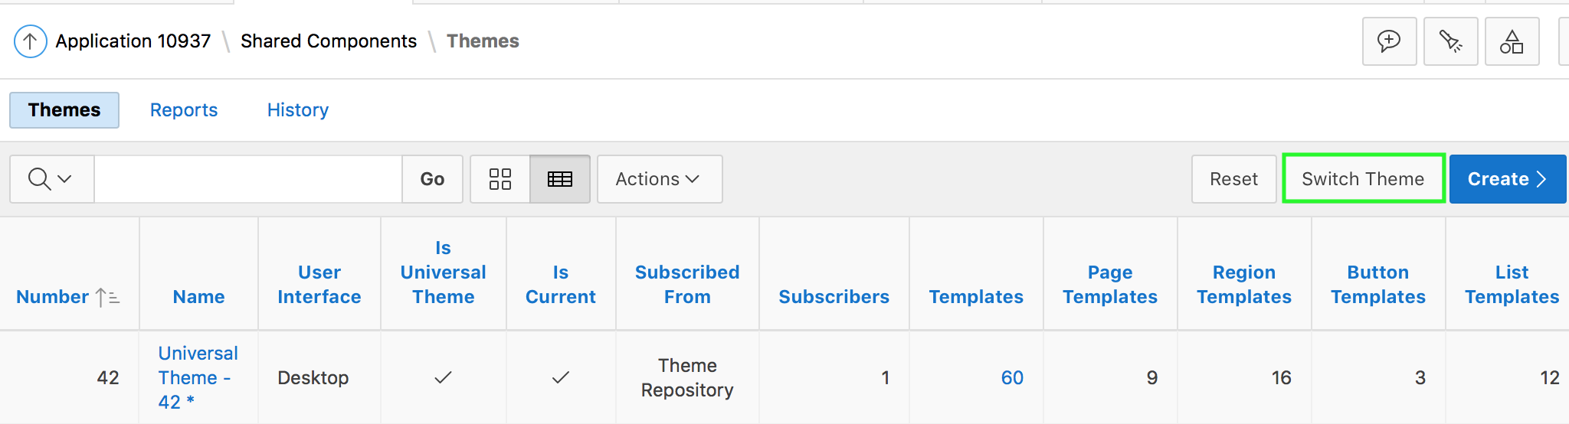
Switching an Active Theme
On the Themes page, click Switch Theme
Specify the current theme for the app and select the new theme to switch to
Review the details in the Verify Compatibility page and resolve the warnings if any
Click Switch to Theme
Notes:
To switch an active theme, navigate to the Themes page, click Switch Theme, and perform the following steps:
For Identify Theme:
Currently Active Theme: Select the current theme for the application.
Switch to Theme: Select the new theme for the application.
Reset Grid: Select whether to reset the grid. Grid settings define the positioning of your regions and items on a page.
Match Template Classes: Select Yes or No. When switching to a new theme, App Builder maps all currently used templates to a template in the new theme using the template class. When Match Template Class is set to No, then templates can be switched to any template with the same type, but irrespective of the template class.
Click Next.
The Verify Compatibility page appears. Review the Status column to identify problematic mappings:
Check indicates the mapping was successful.
Warning indicates there are more than one template in the theme you are switching to with the identified class. The warning provides a select list from which to choose the appropriate template.
Error indicates that App Builder was unable to map the class among the themes. Ensure that a class is identified for the templates in both themes.
Click Next to continue.
Click Switch Theme.
When you switch to a theme, all components with assigned templates are assigned to a corresponding template in the theme. App Builder accomplishes template mapping through the assignment of template class identifiers. When switching an active theme, remember:
You can only switch to a theme if the theme exists. For example, before you can switch to a theme available in the repository, you must first create it.
If the wizard locates multiple matches (that is, when several templates share the same template type and templates class), the wizard defaults to a template matching type, class, and name. If no match is found, you must select another template with the same type and class.
If no matching template is found (that is, no template with the same type and class exists) then you are prompted to select a template with the same type but with a different class. Then, a warning displays explaining this issue might lead to problems with page functionality, or issues with the page display. When no template of the same template type exists, then the theme cannot be switched. You are blocked from switching themes.

Slide 13
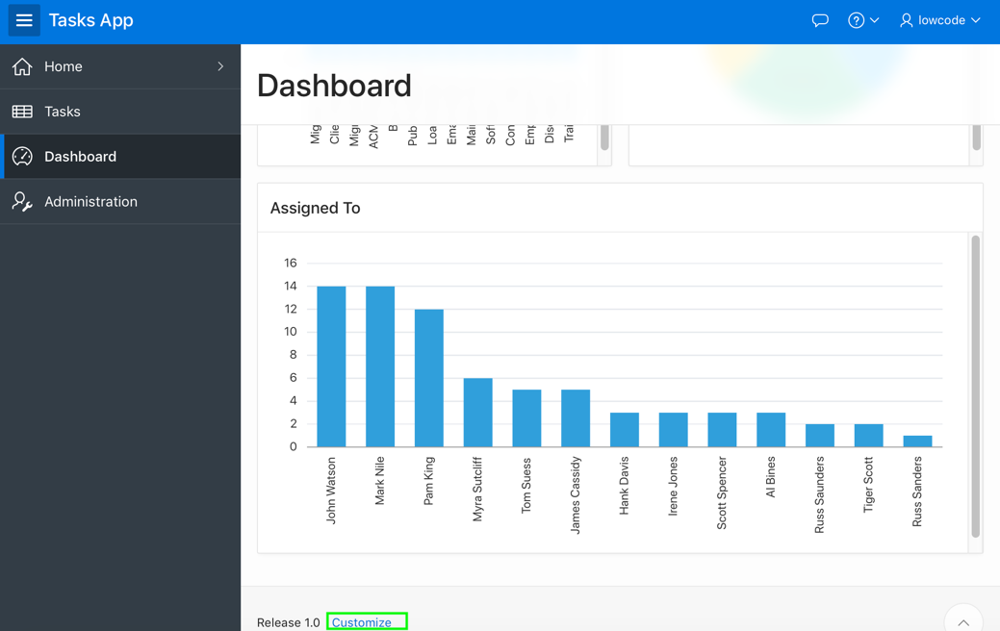
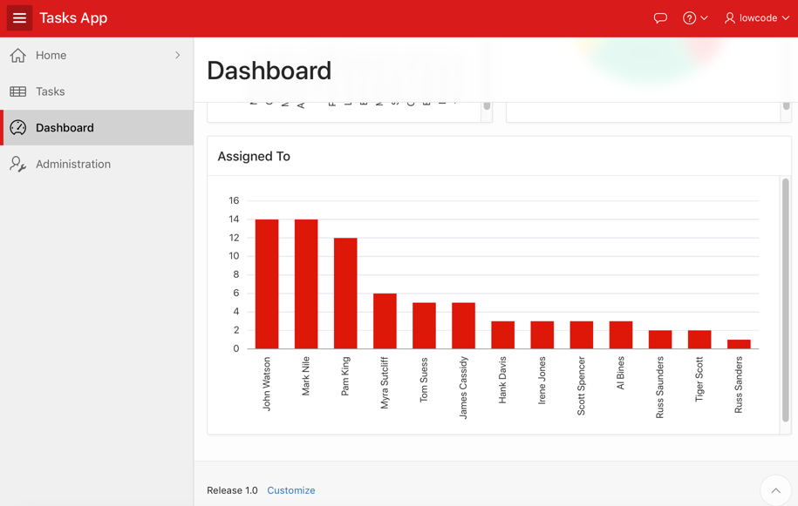
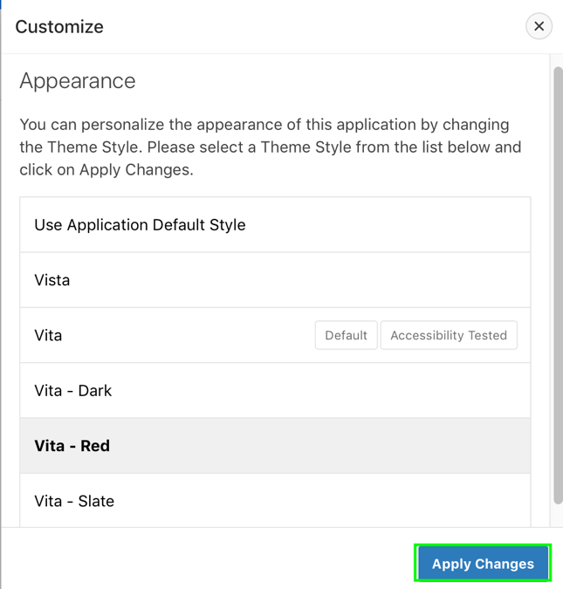
Using Theme Styles
1
Vita
Vita - Red
2
Notes:
The slide example shows that the user changes the theme style to Vita – Red. By applying a theme style on a running application, user can change the look and feel of an application. A theme style defines a CSS style sheet that is added to the base CSS to alter the look and feel of an application.
Developers create a theme style and can enable users to select a theme style in a running application. Once a developer has enabled a theme style, a Customize link appears in the running application, typically in the lower left corner.
End user clicks the Customize link and a pop-up displays listing available theme styles.
In the Customize dialog, when a user selects a theme style, the theme style is stored persistently as a user preference and will be retained during future sessions.
The next few slides cover what a theme style is, how to create a theme style and how to enable end users to select a theme style.

Slide 14
Understanding Theme Styles
You use theme styles to customize themes, switch to a different color scheme, apply a flat look, or make a theme responsive
A theme style defines a CSS style sheet that is added to the base CSS
Universal Theme includes several pre-built styles
You can easily generate additional styles by using the built-in Theme Roller utility
Notes:
A theme style defines a CSS style sheet that is added to the base CSS to alter the look and feel of an application. Universal Theme includes a base CSS file plus the theme style CSS file. The theme style CSS file are referenced in the page template using the #THEME_STYLE_CSS# substitution string. The Application Express engine replaces this substitution string with the CSS file references defined in the theme style attributes. You use theme styles to customize themes, to switch to a different color scheme, apply a flat look, or make a theme responsive. A theme can have multiple theme styles with one style set as active. You can modify a theme style CSS file using Theme Roller.
You learn more about Theme Roller later in this lesson.

Slide 15
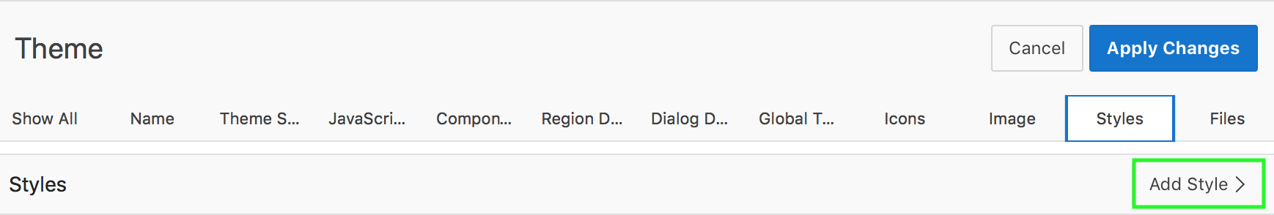
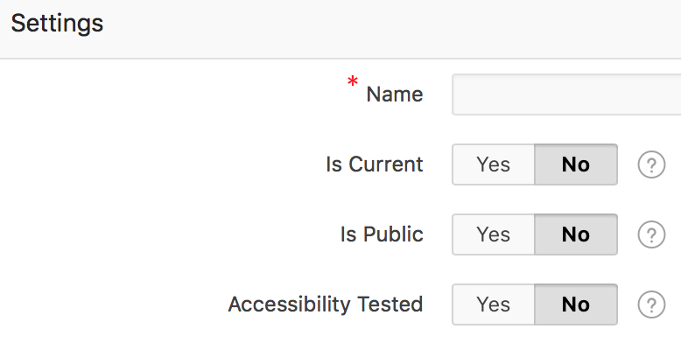
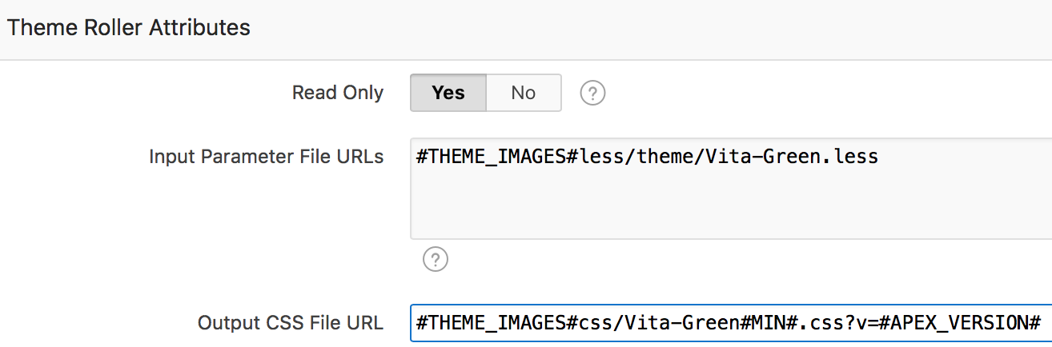
Creating a Theme Style
1
2
3
Notes:
The slide shows steps to create a new theme style. To add a theme style to any theme, perform the following steps:
Navigate to your application home page and select Shared Components. Select the theme in which you want a add a theme style. On the Create/Edit Theme page, click Styles tab and then click Add Style.
The Theme Styles page appears. Under Settings:
Name – Enter a name for the theme style.
Is Current - Select whether this style is the current style used by the theme.
Is Public - Select whether this style can be chosen by end users.
File URLs - Enter Cascading Style Sheet file URLs to be loaded on every page if the theme style is current.
Specify the Theme Roller Attributes and click Create. Under Theme Roller Attributes:
Read Only - Select Yes to prevent any updates to the theme style. Select No to enable the theme style to be edited and overwritten using Theme Roller.
Input Parameter File URLs - Enter the LESS file URLs that will be used to generate this theme style when using Theme Roller.
Output CSS File URL- Enter the URL for the CSS file that will be generated by Theme Roller for this theme style. .
Theme Roller JSON Configuration, JSON Configuration - The JSON configuration is generated by Theme Roller when the theme style is saved. Oracle does not recommend manually updating the configuration. However, you can copy a JSON configuration from another theme style, such as a theme style in another application, to manually update the configuration.
Once defined, developers can edit a theme style by either of the following ways:
Navigating to Shared Components > User Interface > User Interface Attributes page
Navigating to Shared Components > Themes > <your theme> Styles > <your theme style>

Slide 16
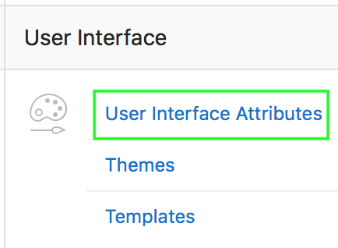
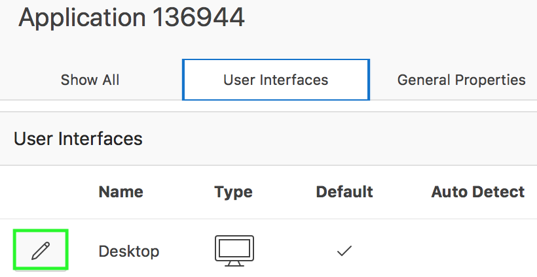
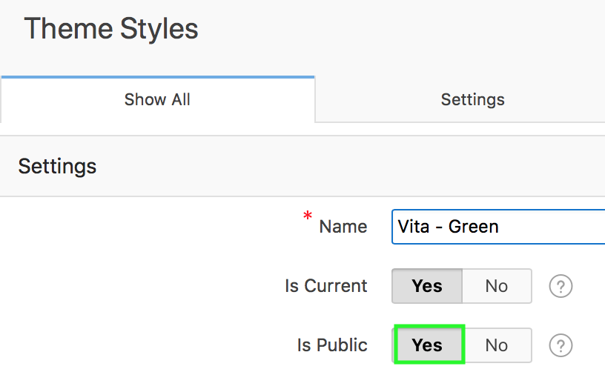
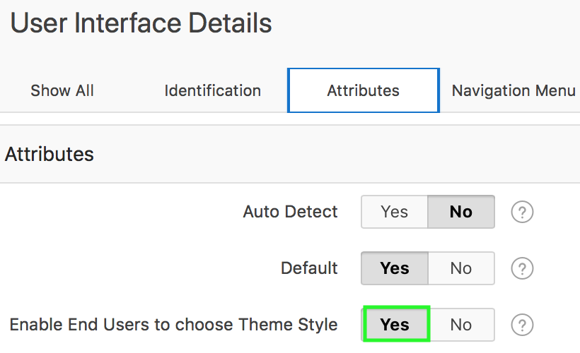
Enabling Users to Select a Theme Style
1
2
4
3
For each theme style, set "Is Public" to "Yes"
Notes:
After creating a theme style, developers can enable users to select this theme style in the running application.
For users to select a theme style, you should have at least two theme styles defined in your application.
Perform the following steps:
Go to the application User Interface page. Click Shared Components. Under User Interface, click User Interface Attributes. The User Interface Attributes page appears. Defined User Interfaces display at the top of the page.
Edit the User Interface Details. Click the Edit icon adjacent to the appropriate user Interface (for example, Desktop).
Under Attributes, set Enable End Users to choose Theme Style to Yes. Click Apply Changes. When set to Yes, end users can choose a Theme Style for their sessions within a customization dialog.
Only Theme Styles marked as "Public" are eligible for selection. Therefore, make sure you edit each theme style and set the Is Public attribute to Yes. To do this:
Navigate to the User Interface page, and click the theme style name
Under Settings, set Is Public to Yes.

Slide 17
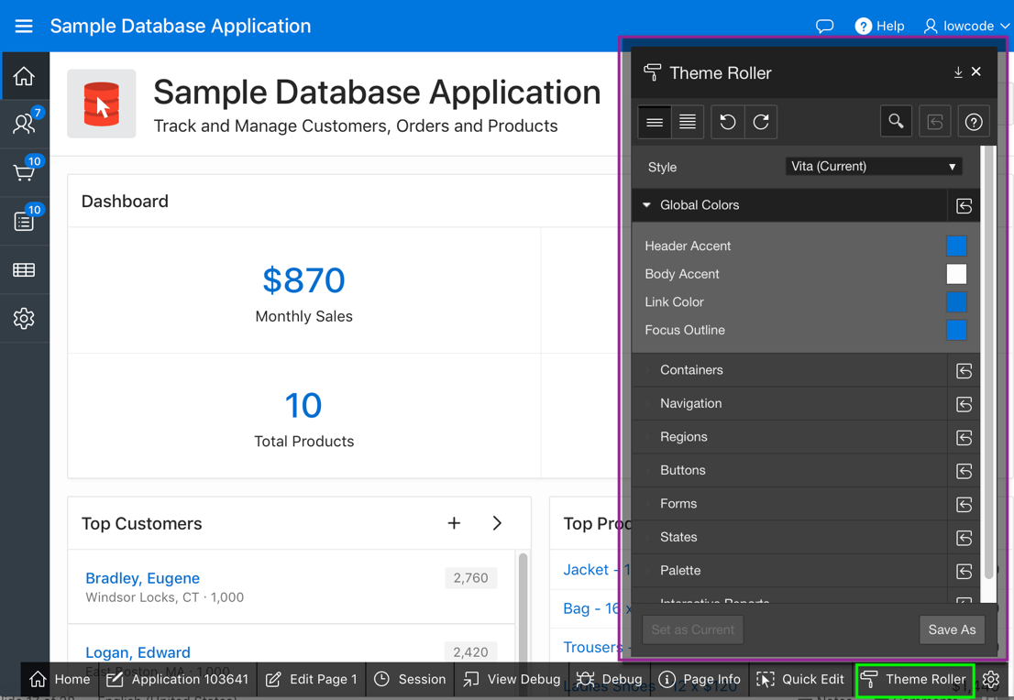
Using Theme Roller
Theme Roller:
Enables easy customization of the look and feel of your application
Allows you to modify a number of style attributes and see changes applied to your application in real time
Allows you to save your changes as a Theme Style
Notes:
Theme Roller is a live CSS editor that enables developers to quickly change the colors, rounded corners and other attributes of their applications without touching a line of code. Theme Roller displays in the Runtime Developer Toolbar if at least one of your theme styles has the Input Parameter File URLs attribute defined.
You can modify a number of style attributes and see changes applied to your application in real time. Once you are satisfied with the result, you can save your changes as a Theme Style directly to your application.
To use Theme Roller, preview a page by running it. When a developer run a desktop application, the Runtime Developer toolbar displays at the bottom of any editable running page. Theme Roller only displays in the Runtime Developer Toolbar if theme styles have been defined.
Perform the following steps:
Click Theme Roller on the Runtime Developer Toolbar. Theme Roller fetches the styles for your application and loads them in the editor.
From Style, select a new style, choose an existing style from the list.
Under Global Colors, click the color swatch to select new colors.
To edit a specific component, expand a group and select new colors or styling of the component you wish to edit.
To set the theme style you are working as the current one for the application, click Set as Current.
If the selected theme is read only, then click Save As to save your changes as a new theme.
Run a packaged application that uses the Universal Theme - 42 to see an example of Theme Roller.

Slide 18
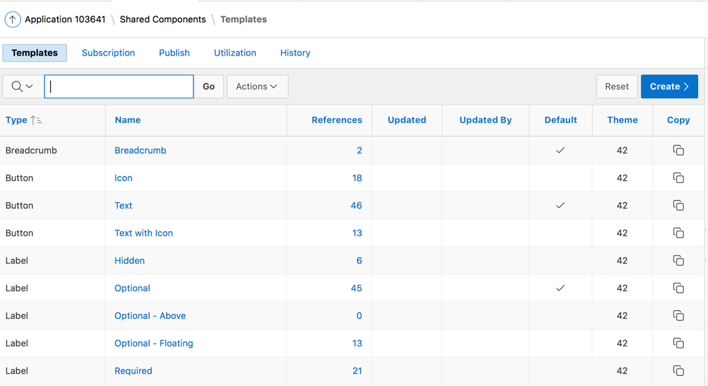
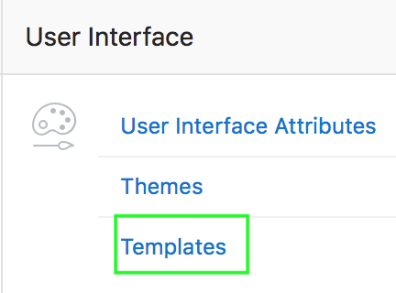
Understanding Templates
The Application Express engine constructs the appearance of each page in an application using Templates
Templates define how pages, page controls, and page components display
Notes:
The Application Express engine creates the user interface of an application based on a named collection of templates called a theme. Templates control the look and feel of the components in your application. If you must create a custom template, it is generally easier to start with an existing template and then modify it. Once you have created one or more default templates, you can modify those templates to fit your specific needs.
You can view all available templates on the Templates page. Alternatively, you can access a template associated with a specific page. The slide shows all the available templates in an application on the Templates page.
To view existing templates:
On the Workspace home page, click the App Builder icon. Select an application. Click Shared Components.
Under User Interface, select Templates. The Templates page displays as an interactive report.
To view or edit a template definition, click the template name. The template definition appears.
Edit the appropriate attributes.
Click Apply Changes.
Note: If you edit a template, you can make changes in one window and run your application in another by selecting the Return to Page check box on the right side of the template definition page. Selecting this check box keeps the page you are editing current after you click Apply Changes.
Templates are organized first by template type and then by template class. Template types include page, region, report, list, button,
label, and popup list of values (LOV).

Slide 19
Understanding Template Options
Template options provide a declarative way for developers to apply different styles to components on an application page
Examples of how developers can use template options include:
Applying different colors or accents
Applying different spacing and padding
Rendering buttons in different styles, with and without icons
Displaying form fields with different alignments
Application components that support template options:
Pages ,regions, classic reports
Breadcrumbs, lists, items and labels, and buttons
Notes:
Template options enable developers to declaratively apply CSS modifiers to the templates they have chosen for pages, regions, reports, lists, breadcrumbs, items and buttons. A CSS modifier is a reference to a CSS class defined in a CSS style sheet. CSS modifiers enable a developer to use the same HTML markup but present it in a variety of different styles simply by applying a CSS. Template options reduce the need to have a large number of nearly identical templates defined in a theme in order to achieve different styles for button colors, region widths, font settings, item label markup, and so on.
The slide shows a few examples of how developers can use template options. Without template options, applying the variations would require a large number of nearly identical templates, or in-depth knowledge of CSS. Components that support template options include: pages; regions; classic reports; breadcrumbs; lists; items and labels; and buttons.
Developers can select template options that are not part of a template option group to be the default for a template. App Builder automatically applies default template options by rendering the component that references the template. Default template options are not written to an actual component. Instead, a #DEFAULT# substitution string is defined for the component, thus enabling developers to centrally modify the template option defaults.
Developers can define the purpose of related template options by creating template option groups. Examples of template option groups include Button Size, Button Style, List Examples, List Style, and Form Label Position.

Slide 20
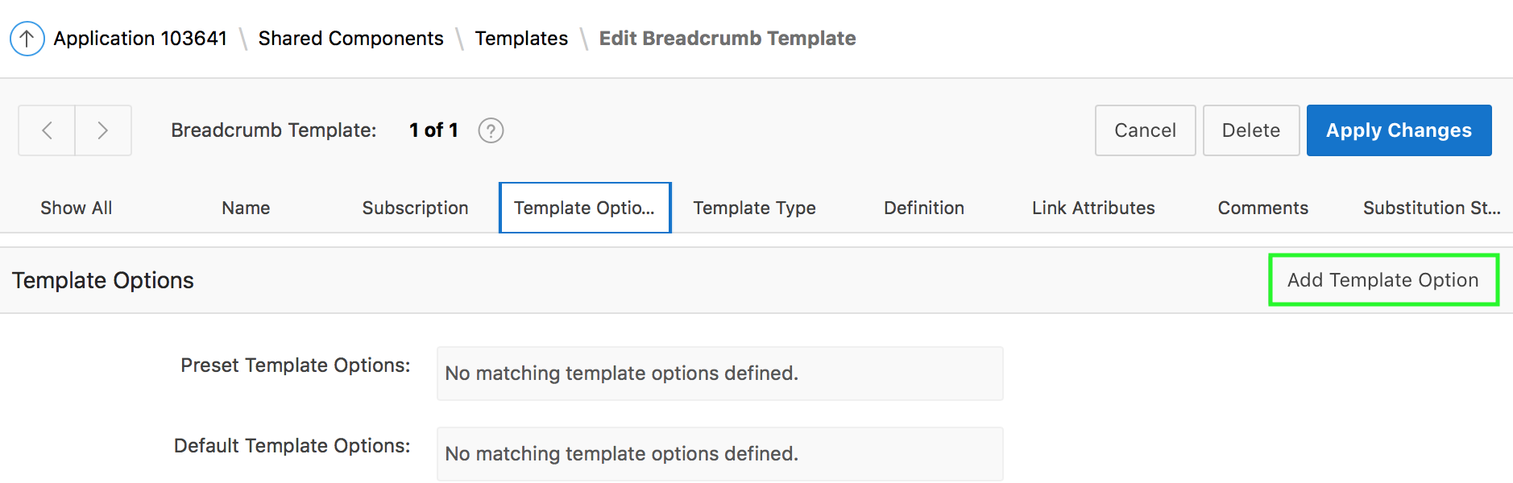
Creating Template Options
Notes:
To create a template option, perform the following steps:
On your application home page, click Shared Components
Under User Interface, select Templates. Select a template.
Select Template Options
Click Add Template Option.
Edit the appropriate attributes.
Click Create or Create and Add Another.

Slide 21
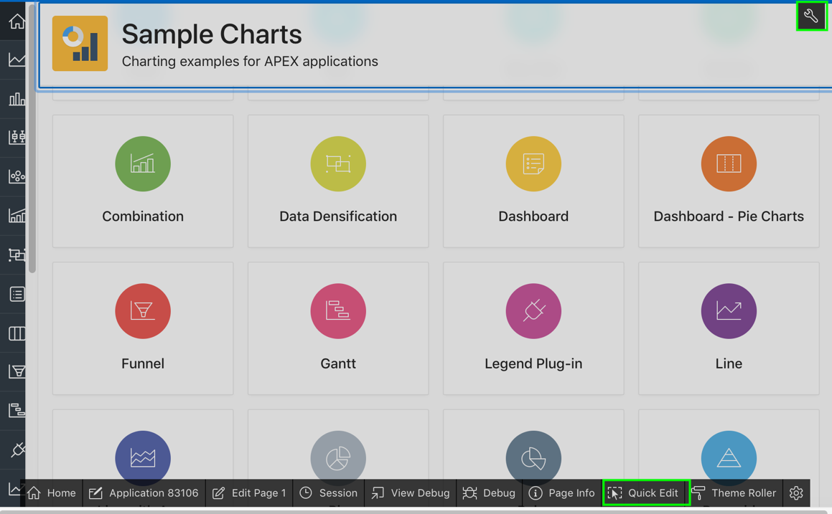
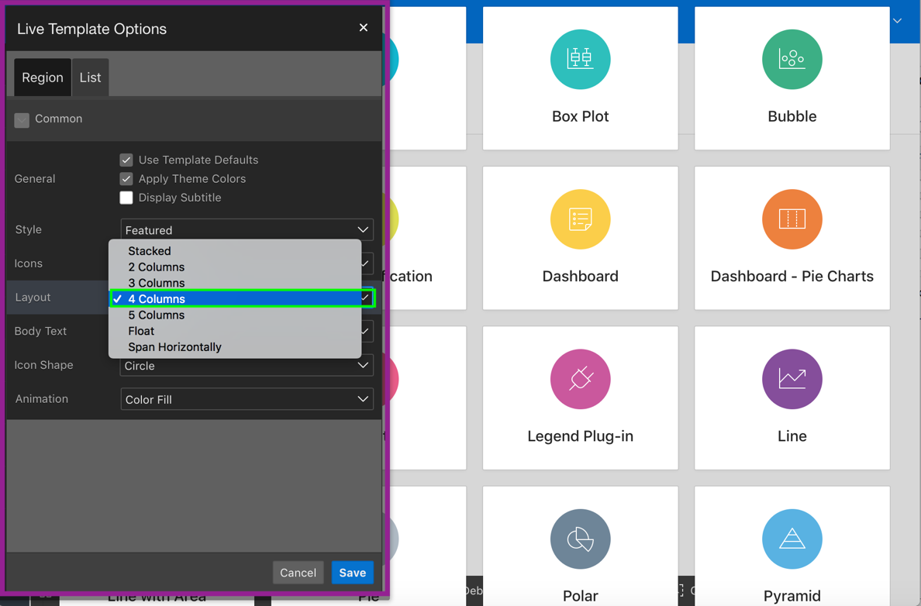
Using Live Template Options
Notes:
You can modify template options for your page components when running the application. Just like Theme Roller, Live Template Options enables you to customize your application in real time, allowing you to try out various template options to get the perfect UI for your application. Developers can simply use Quick Edit on the Runtime Developer toolbar to access the Live Template Options dialog. Using the Live Template Options dialog, developers can alter component's template options without refreshing the page.
The slide example shows using Live Template Options on the Sample Charts application home page. In the example, under Layout, you specify 5 columns. As you modify the attributes, you see the changes applied to the UI without even refreshing the page.
To access the Live Template Options, perform the following steps:
Run the page. From the Runtime Developer toolbar, click Quick Edit.
Move the mouse over the component for which you want to modify template options.
Click the Wrench icon in the upper right corner. The Live Template Options dialog appears. For region-based components, such as lists and classic reports, the dialog includes an Attributes tab.
Select the appropriate tab, edit the appropriate attributes, and click Save.

Slide 22
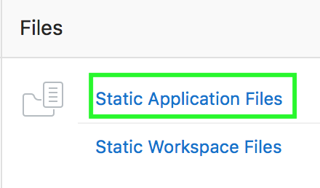
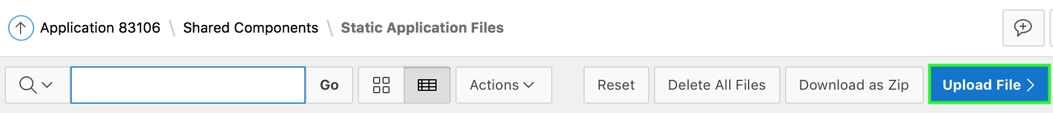
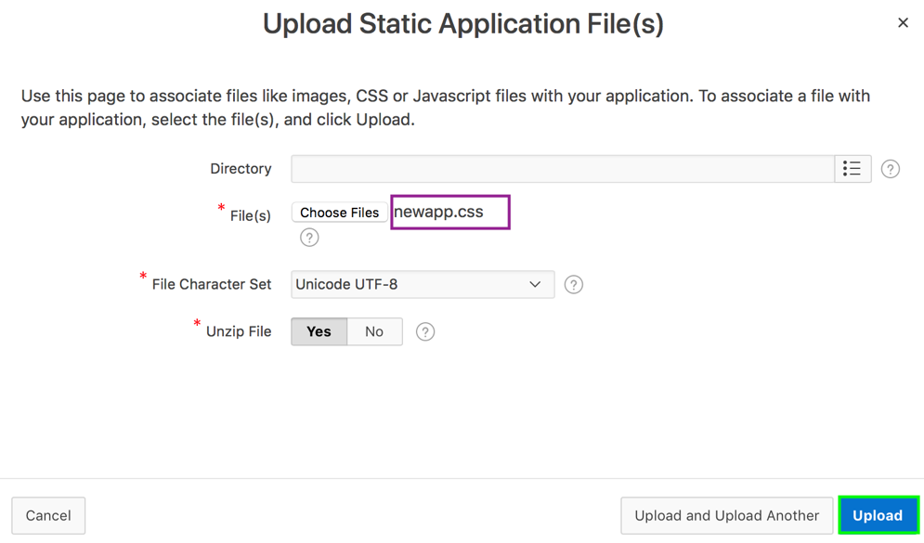
Using Custom Cascading Style Sheets
1
2
3
Notes:
The slide shows steps to upload a custom cascading style sheet. A cascading style sheet (CSS) provides a way to control the style of a web page without changing its structure. When used properly, a CSS separates visual attributes such as color, margins, and fonts from the structure of the HTML document. The style rules defined in each CSS for a particular theme also determine the way reports and regions display.
You can upload files (including CSS files) for use by a specific application or all applications within a Workspace.
To upload a CSS, perform the following steps:
Navigate to your application home page and click Shared Components.
Under Files, select Static Application Files.
Click Upload File.
Select the directory where the file has to be uploaded. You can leave it blank to save it under Root.
Browse to your local directory and locate your .css file. Then, click Upload. The file is now uploaded successfully.
You can reference an uploaded cascading style sheet within the Header section of the page template. You use the Header section to enter the HTML that makes up the <HEAD> section of the HTML document.
To reference an uploaded cascading style sheet, perform the following steps:

Slide 23
Referencing an Uploaded CSS in the Page Template
Navigate to your application home page and click Shared Components.
Under User Interface, select Themes. The Themes page appears.
Select your theme and then, on the Tasks list, click View Templates.
Select the name of the page template you want to edit.
Use the <link> tag within the Header section to reference the appropriate style sheet.
Use the substitution string #APP_IMAGES# to reference an uploaded file that is associated with a specific application
Use the substitution string #WORKSPACE_IMAGES# to reference an uploaded file that is associated with a specific Workspace
Notes:
You can reference an uploaded cascading style sheet within the Header section of the page template. You use the Header section to enter the HTML that makes up the <HEAD> section of the HTML document.
The slide shows steps to reference an uploaded cascading style sheet in an application.
To reference an uploaded file that is associated with a specific application, you would use the substitution string #APP_IMAGES#. For example:
<html>
<head>
<title>#TITLE#</title>
#HEAD#
<link rel="stylesheet" href="#APP_IMAGES#sample2.css" type="text/css">
</head>
...
To reference an uploaded file that is associated with a specific workspace, you would use the substitution string #WORKSPACE_IMAGES#. For example:
<html>
<head>
<title>#TITLE#</title>
#HEAD#
<link rel="stylesheet" href="#WORKSPACE_IMAGES#sample3.css" type="text/css">
</head>
...

Slide 24
Summary
In this lesson, you learned how to:
Create and use a new theme
Switch a Theme
Use Theme Styles
Use Theme Roller, and Live Template Options
Upload and use a CSS

Slide 25


Slide 26
Hands-on Lab

